Slide 1
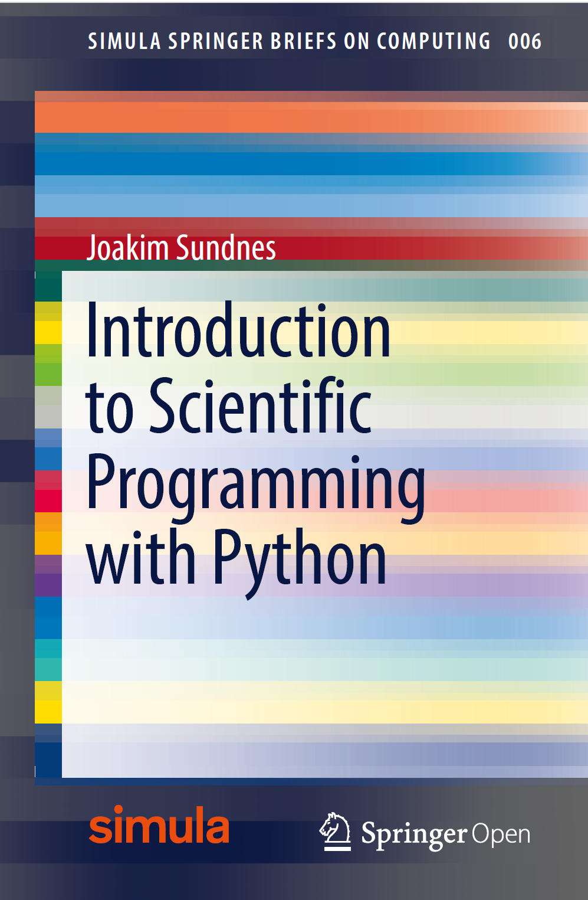
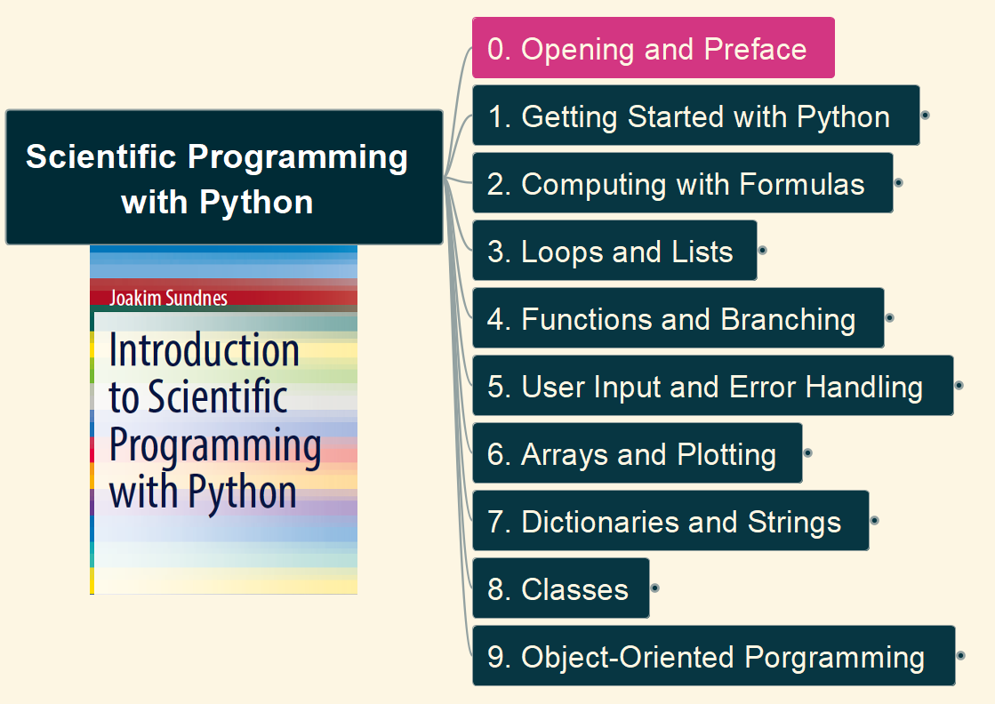
Scientific Programming with Python
001
Opening and Preface

Slide 2
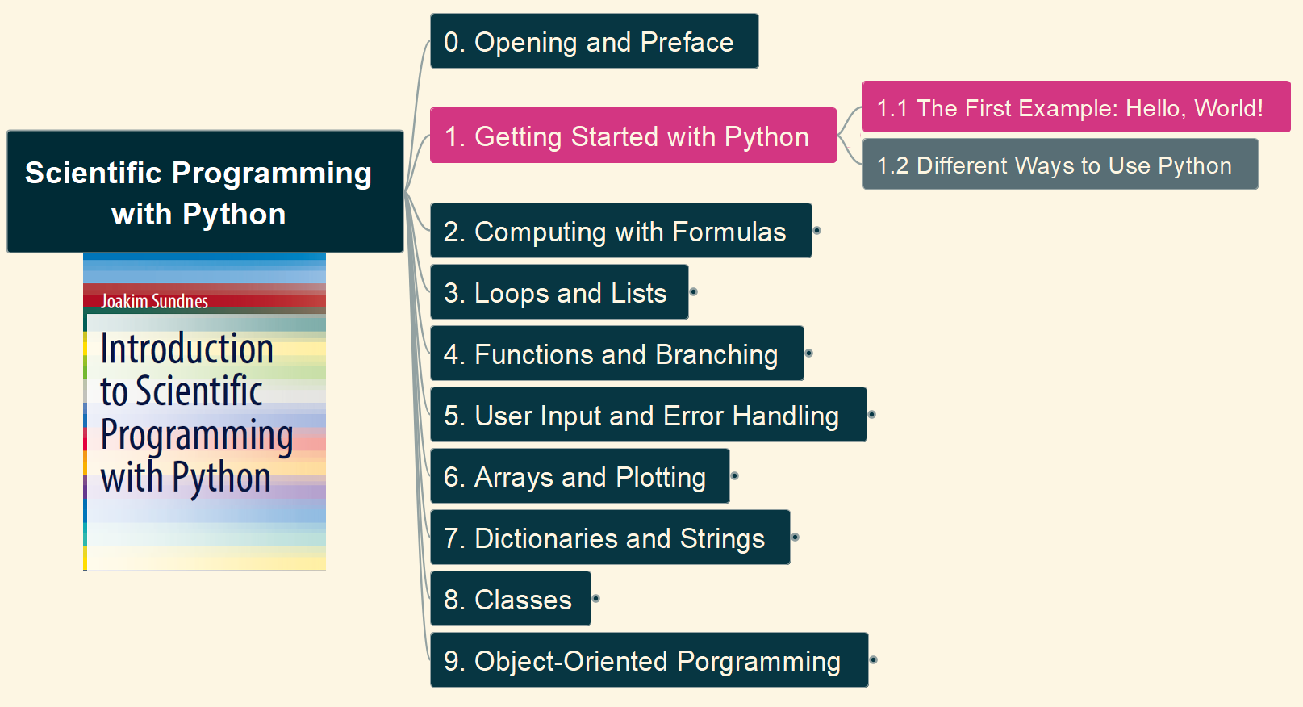

1. Getting Started with Python 1.1 The First Example: Hello, world
002

Slide 3
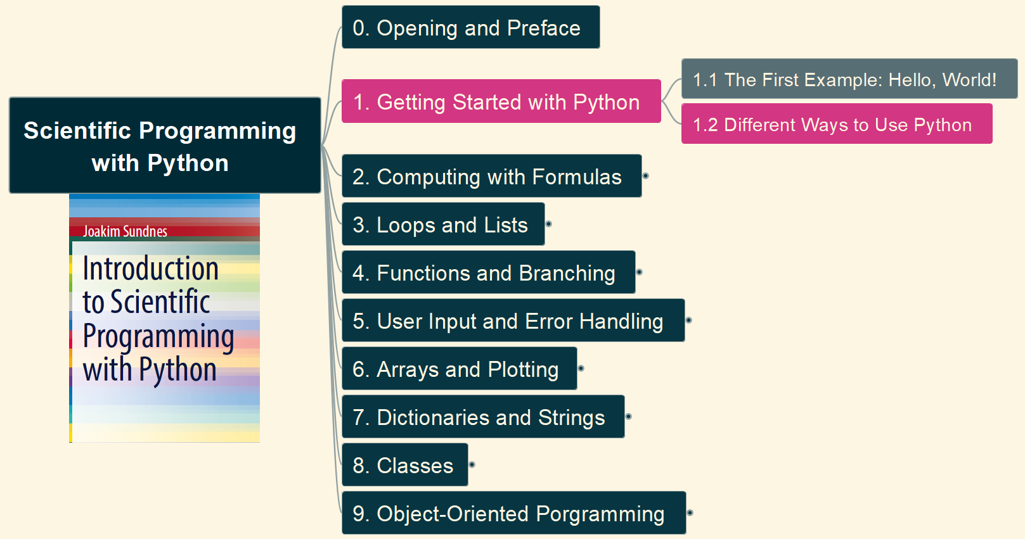
1. Getting Started with Python 1.2 Different Ways of Use Python
003

Slide 4
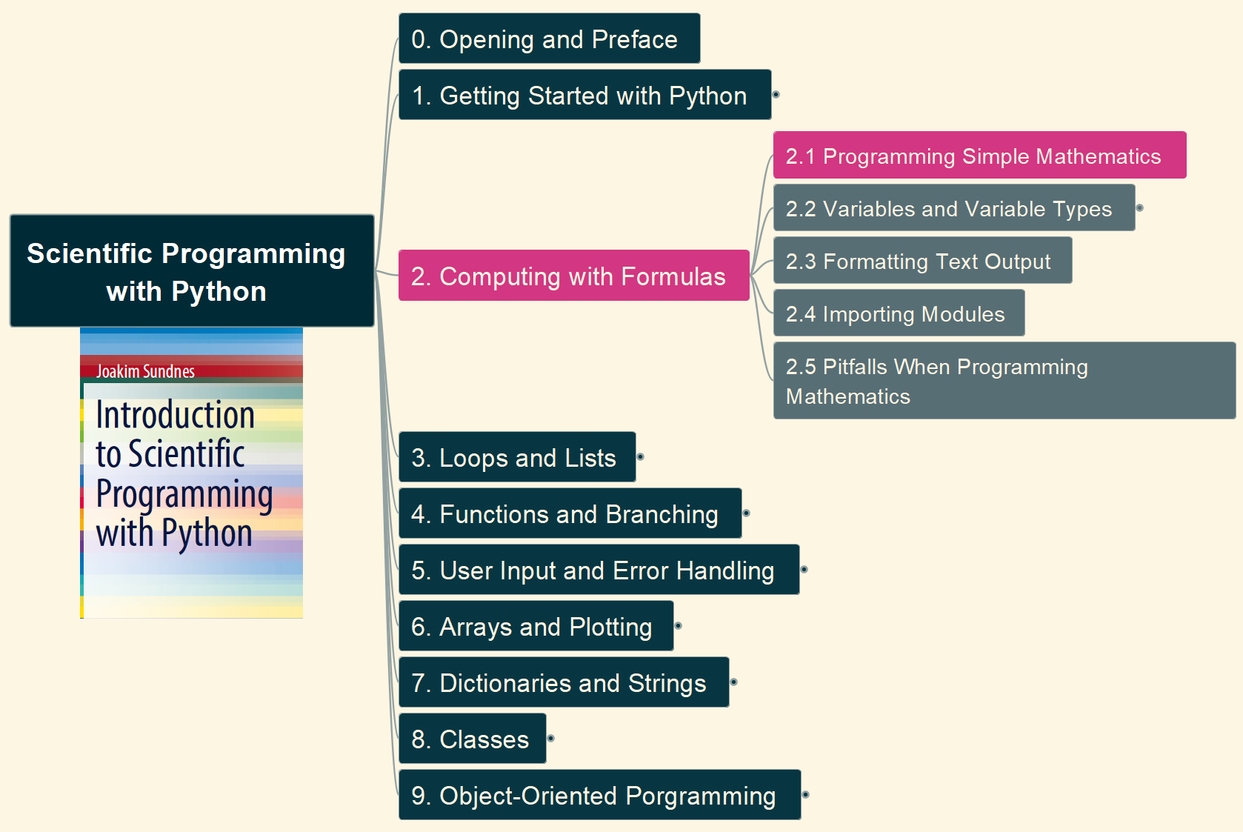
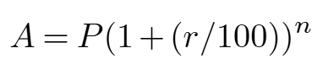
2. Computing with Formulas 2.1 Programming Simple Mathematics
004

Slide 5
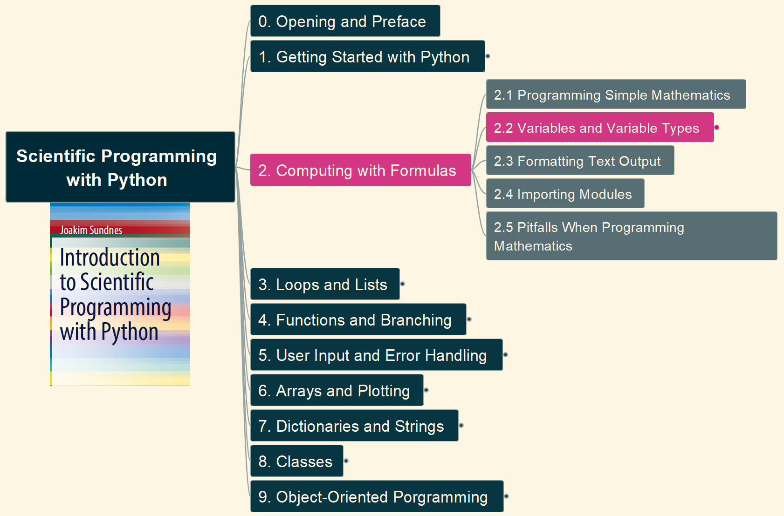
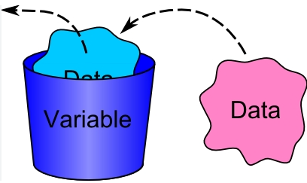
2. Computing with Formulas 2.2 Variables and Variable Types (1)
005

Slide 6
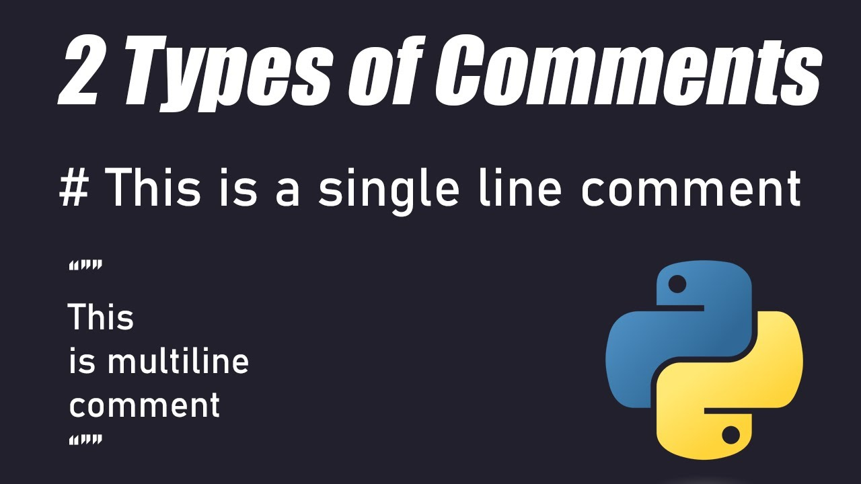
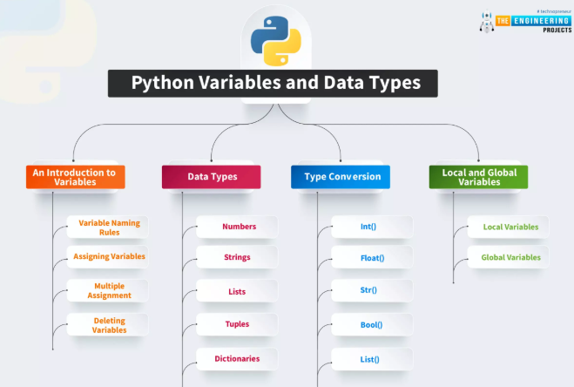
2. Computing with Formulas 2.2 Variables and Variable Types (2)
006

Slide 7
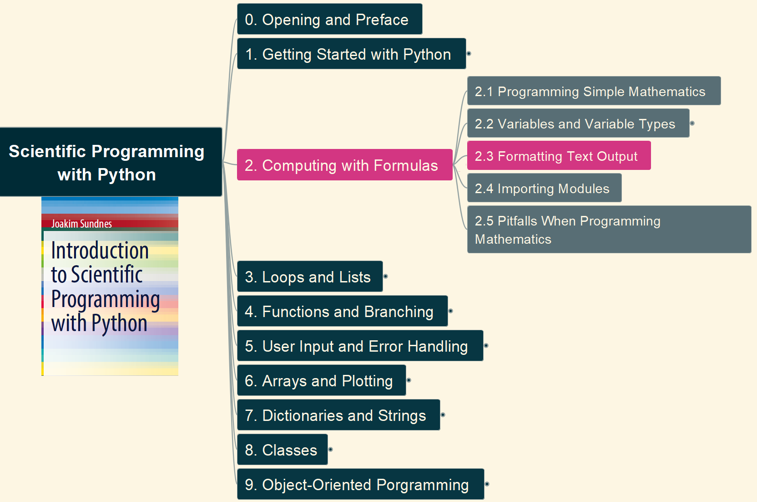
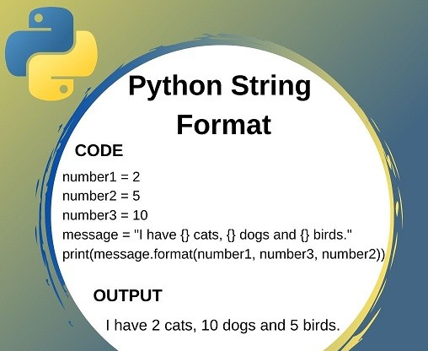
2. Computing with Formulas 2.3 Formatting Text Output
007

Slide 8
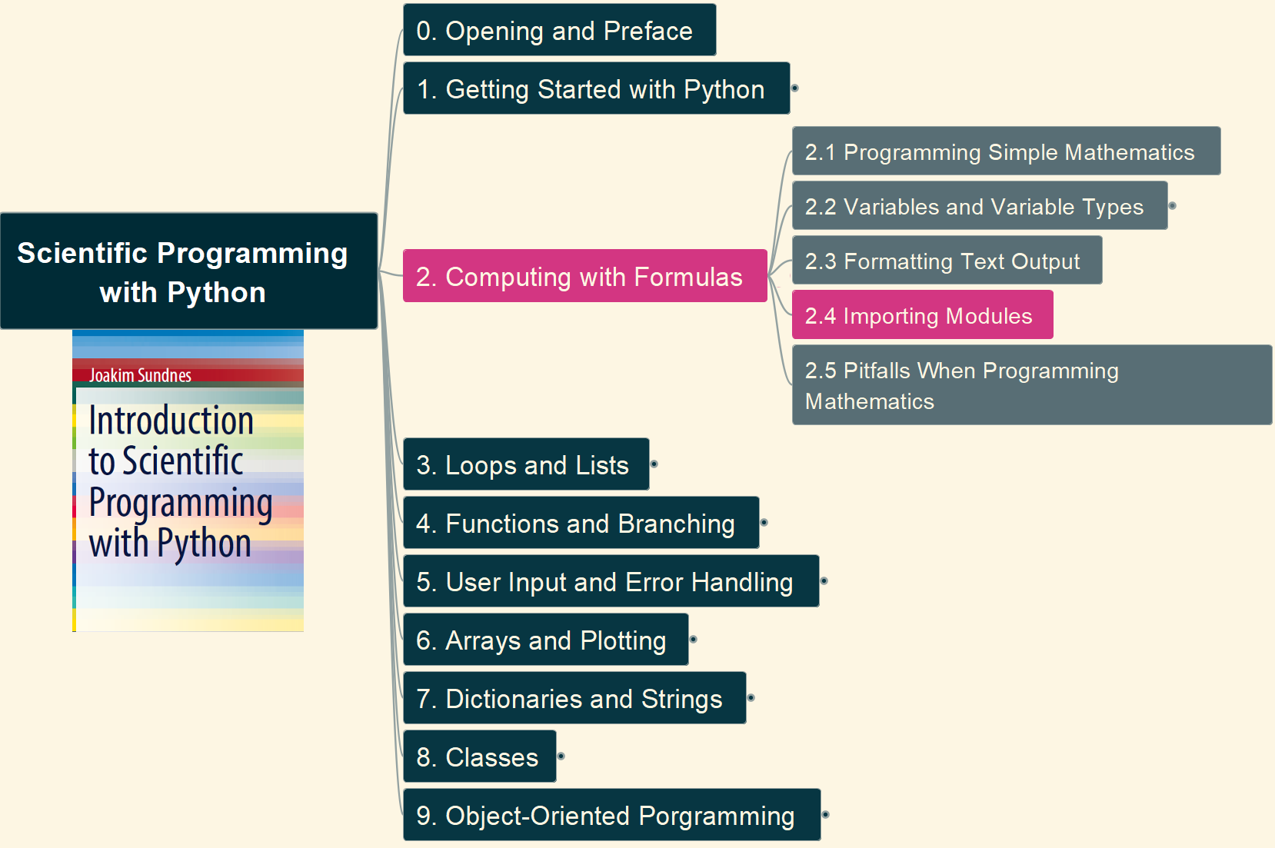
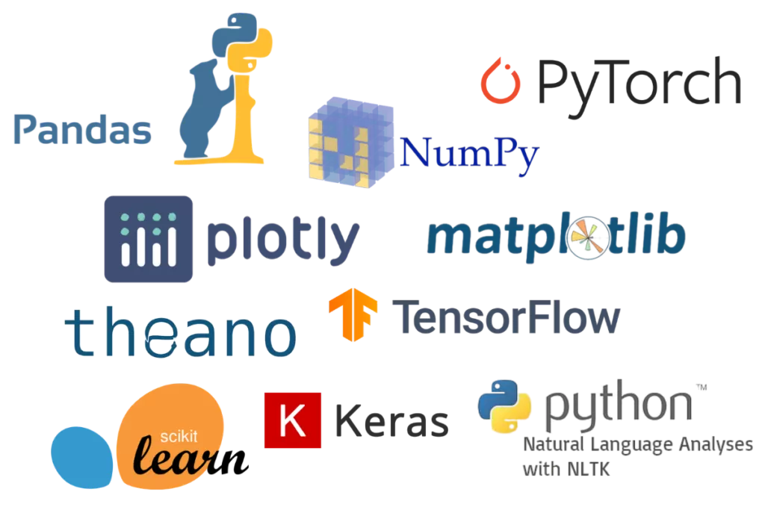
2. Computing with Formulas 2.4 Importing Modules
008

Slide 9
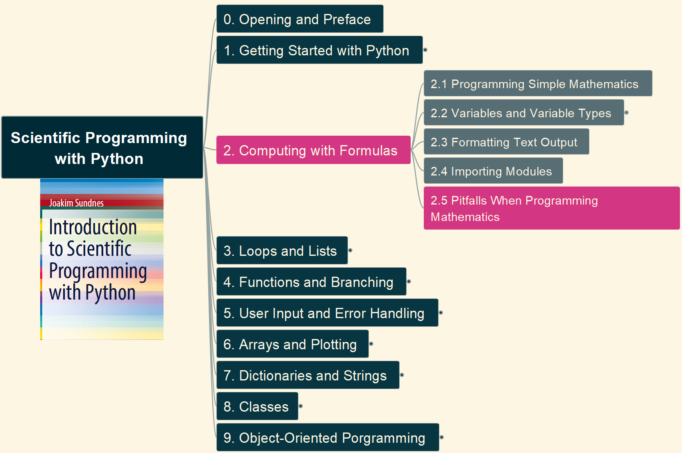

2. Computing with Formulas 2.5 Pitfalls When Programming Mathematics
009

Slide 10
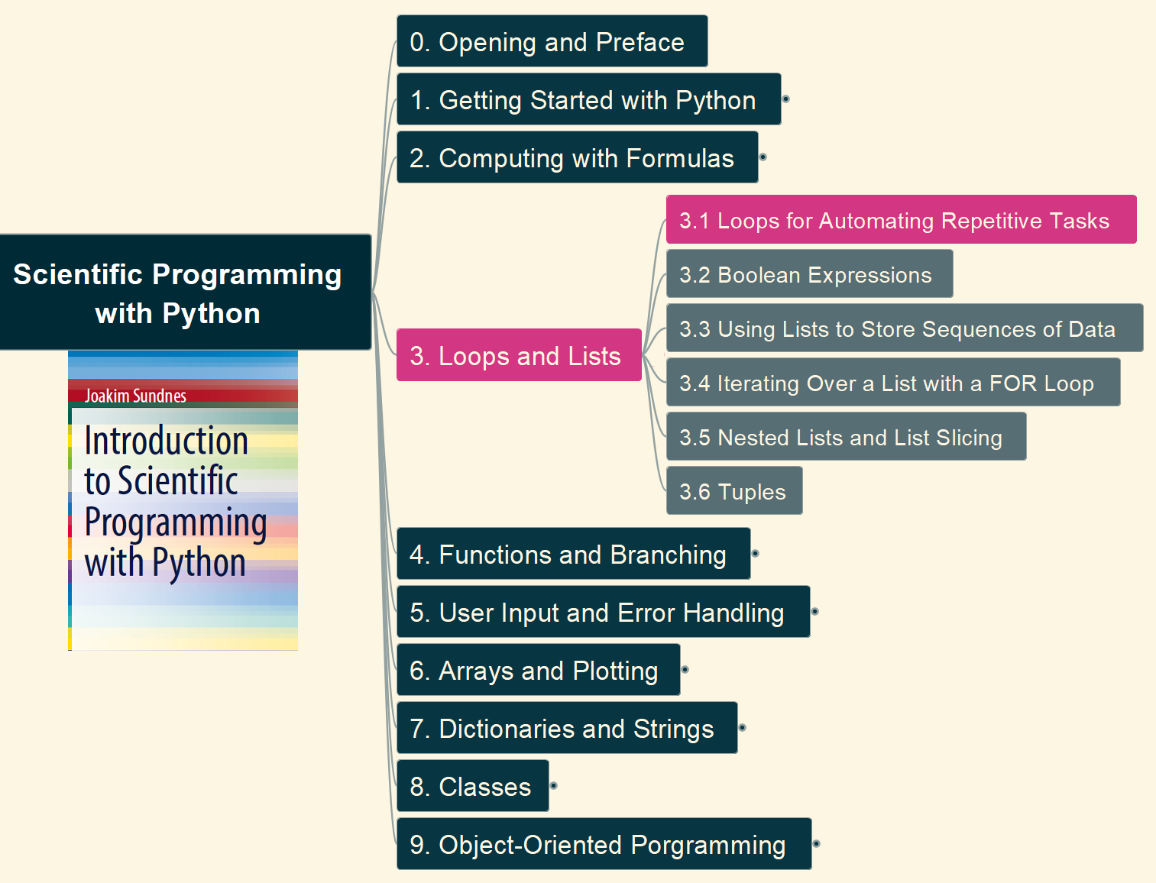
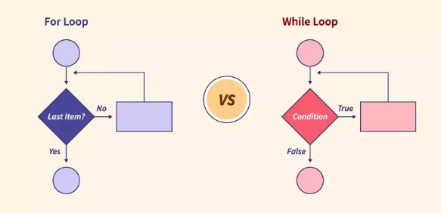
3. Loops and Lists 3.1 Loops for Automating Repetitive Tasks
010

Slide 11
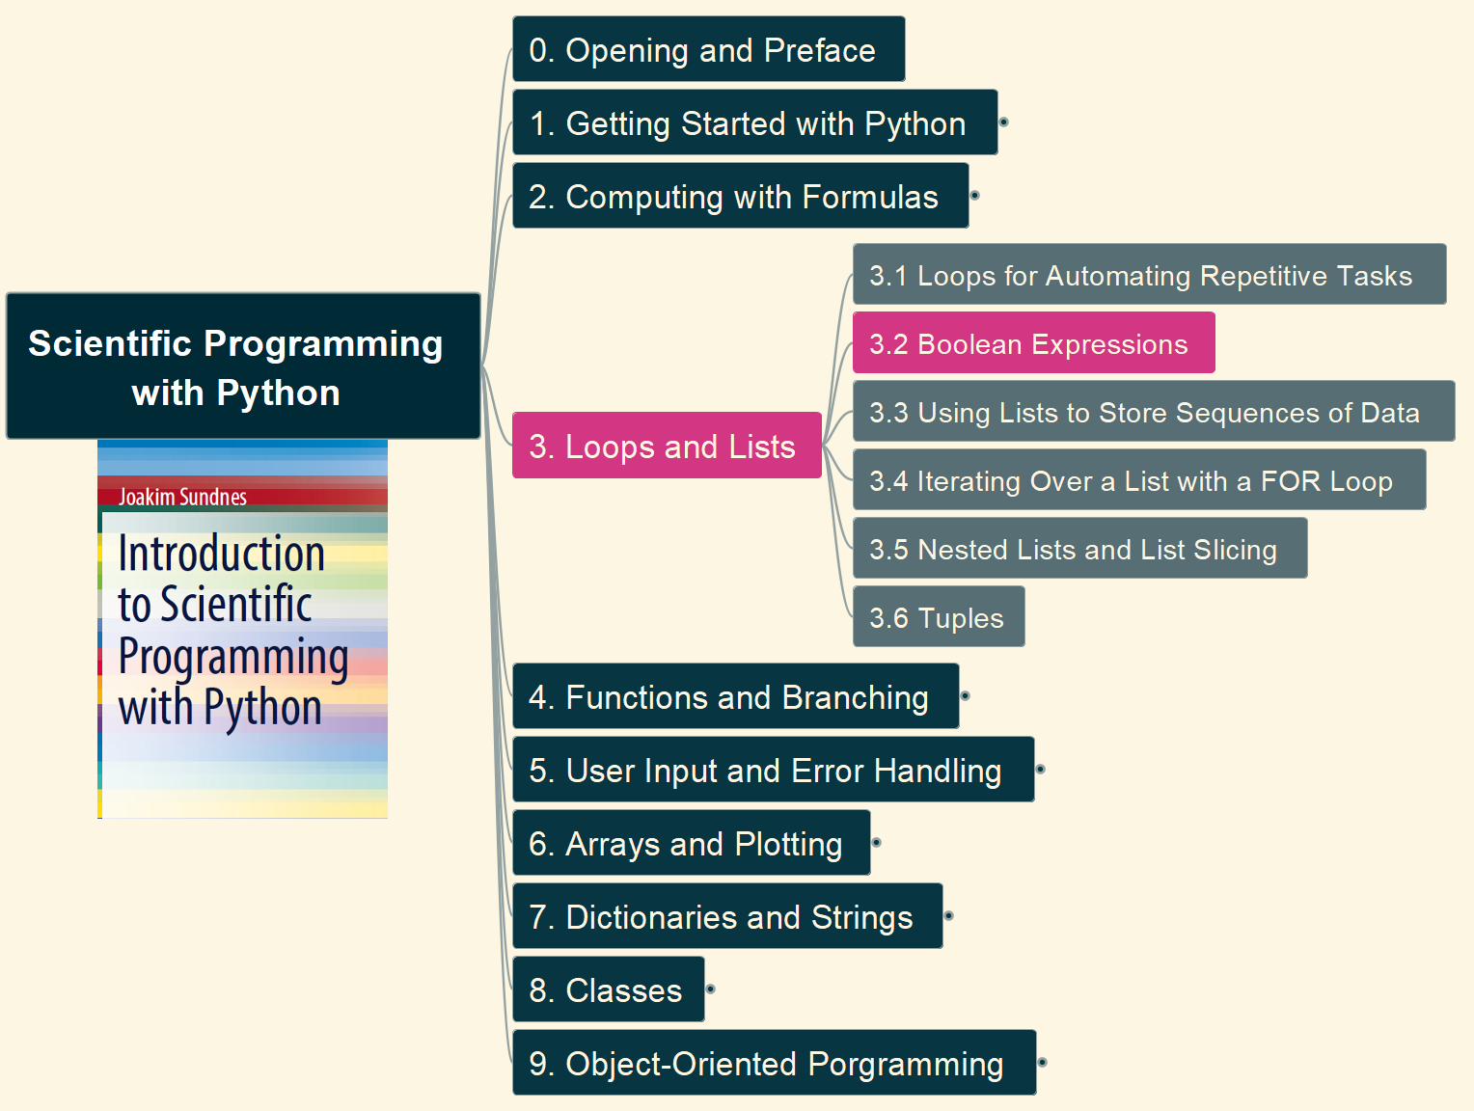
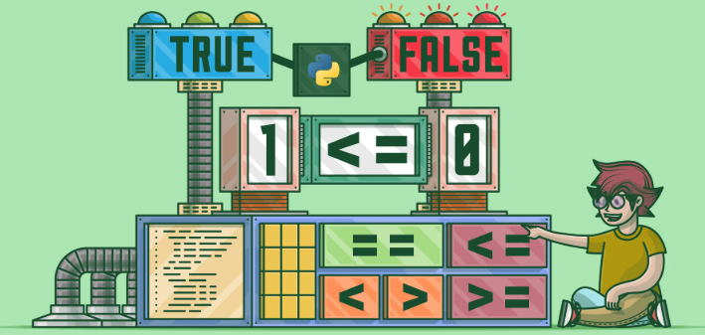
3. Loops and Lists 3.2 Boolean Expressions
011

Slide 12
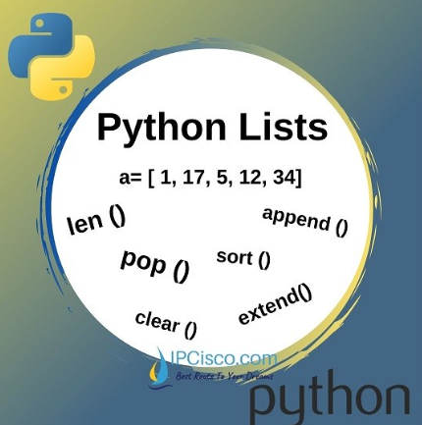
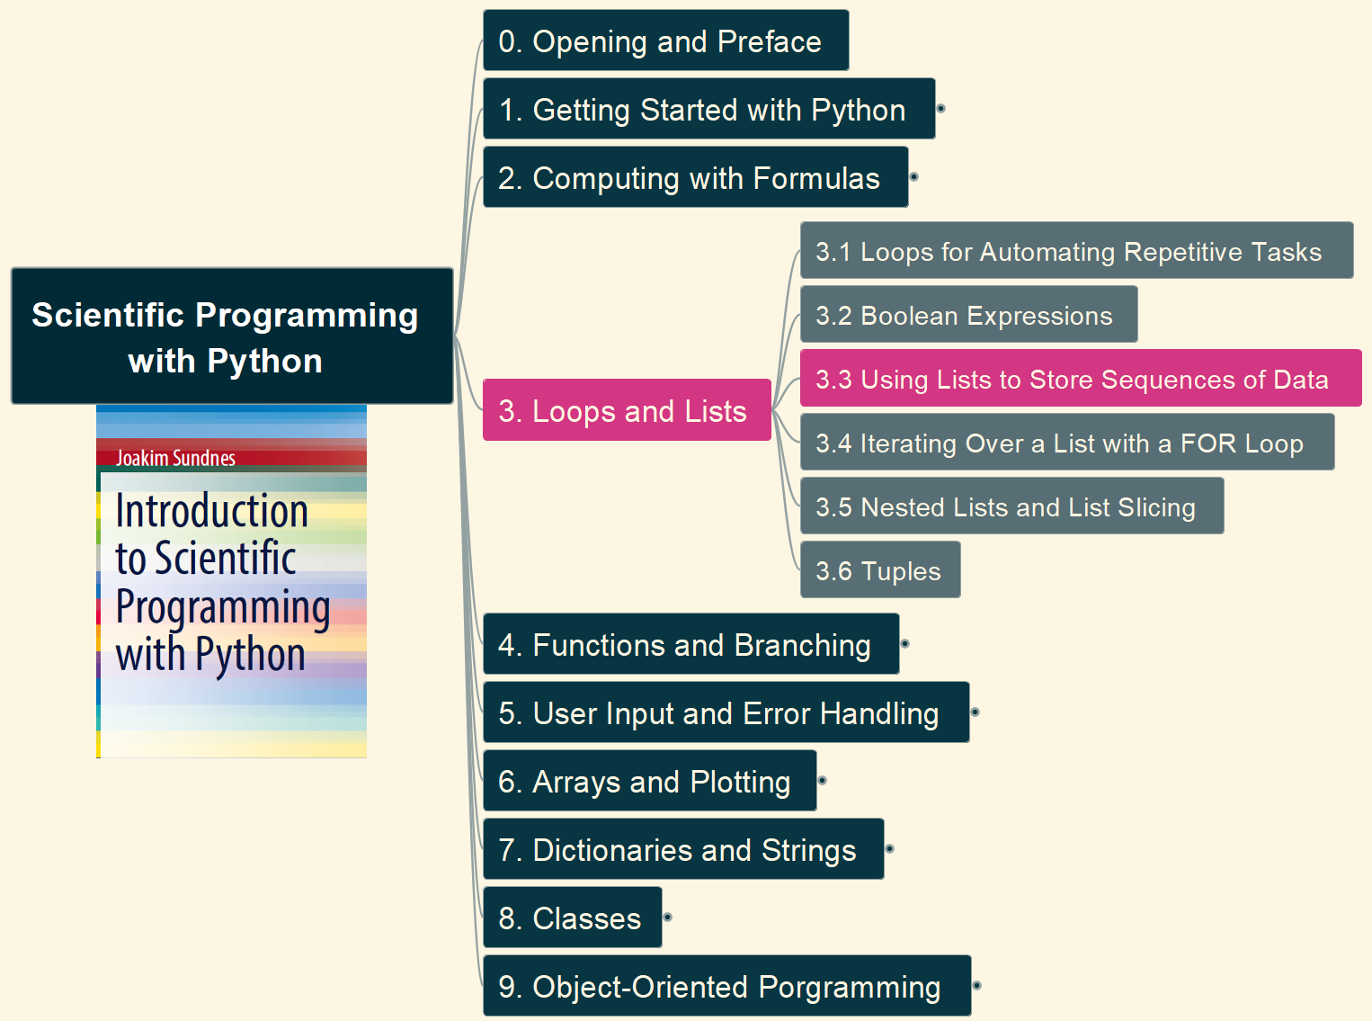
3. Loops and Lists 3.3 Using Lists to Store Sequences of Data
012

Slide 13
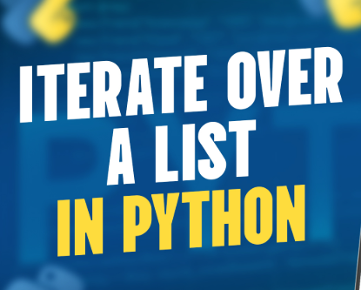
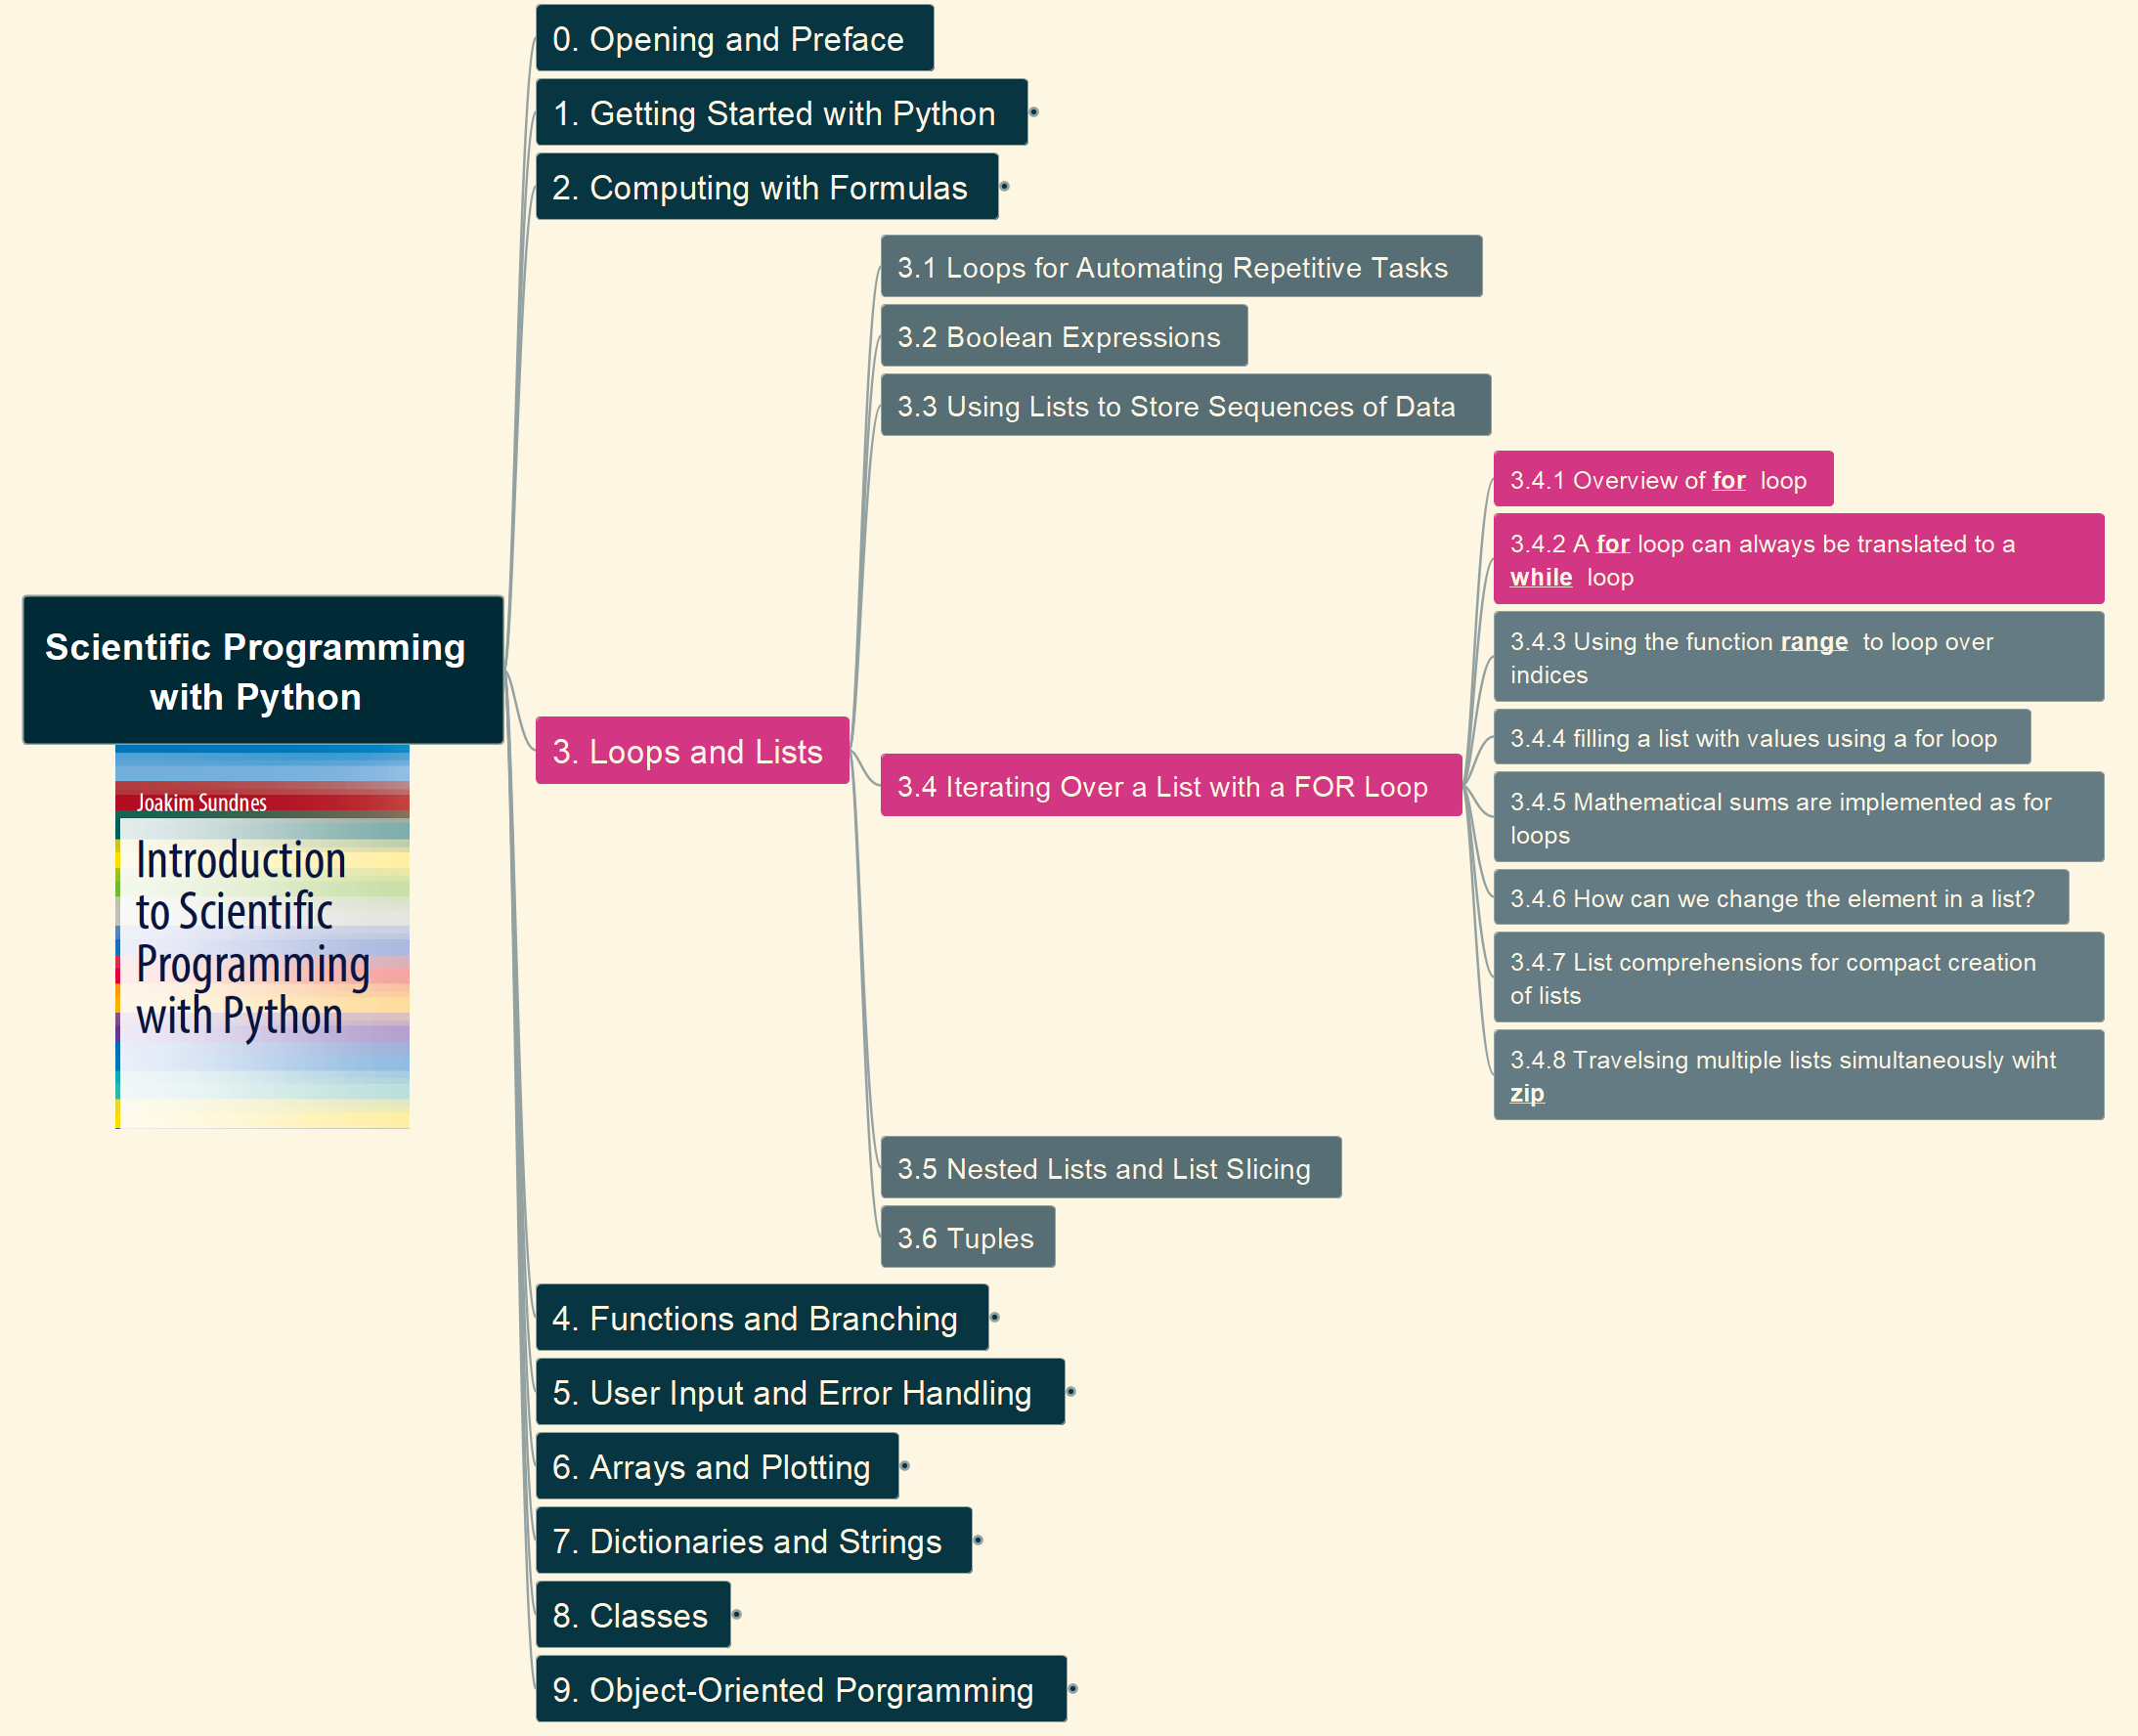
3. Loops and Lists 3.4 Iterating Over a List with a FOR Loop – (1)
013

Slide 14
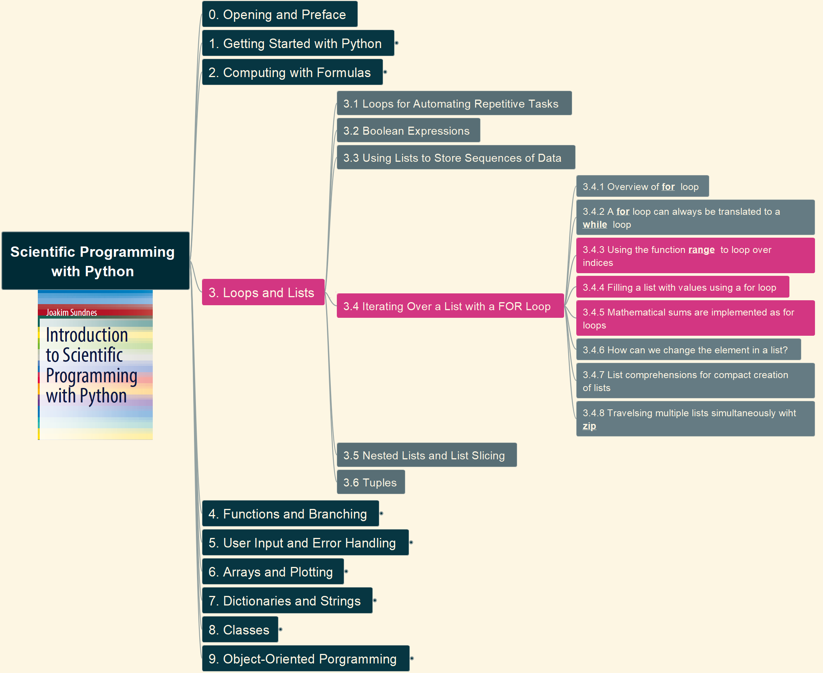
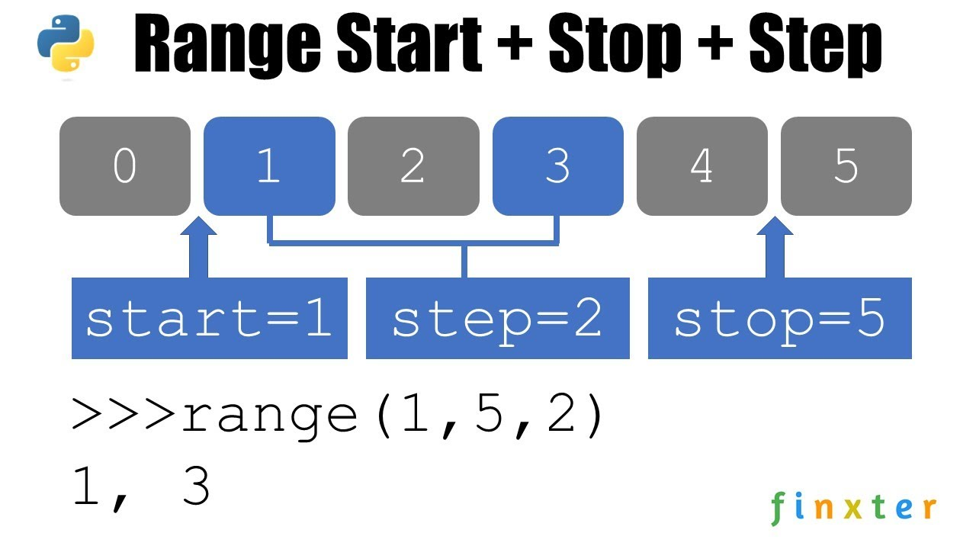
3. Loops and Lists 3.4 Iterating Over a List with a FOR Loop – (2)
014

Slide 15
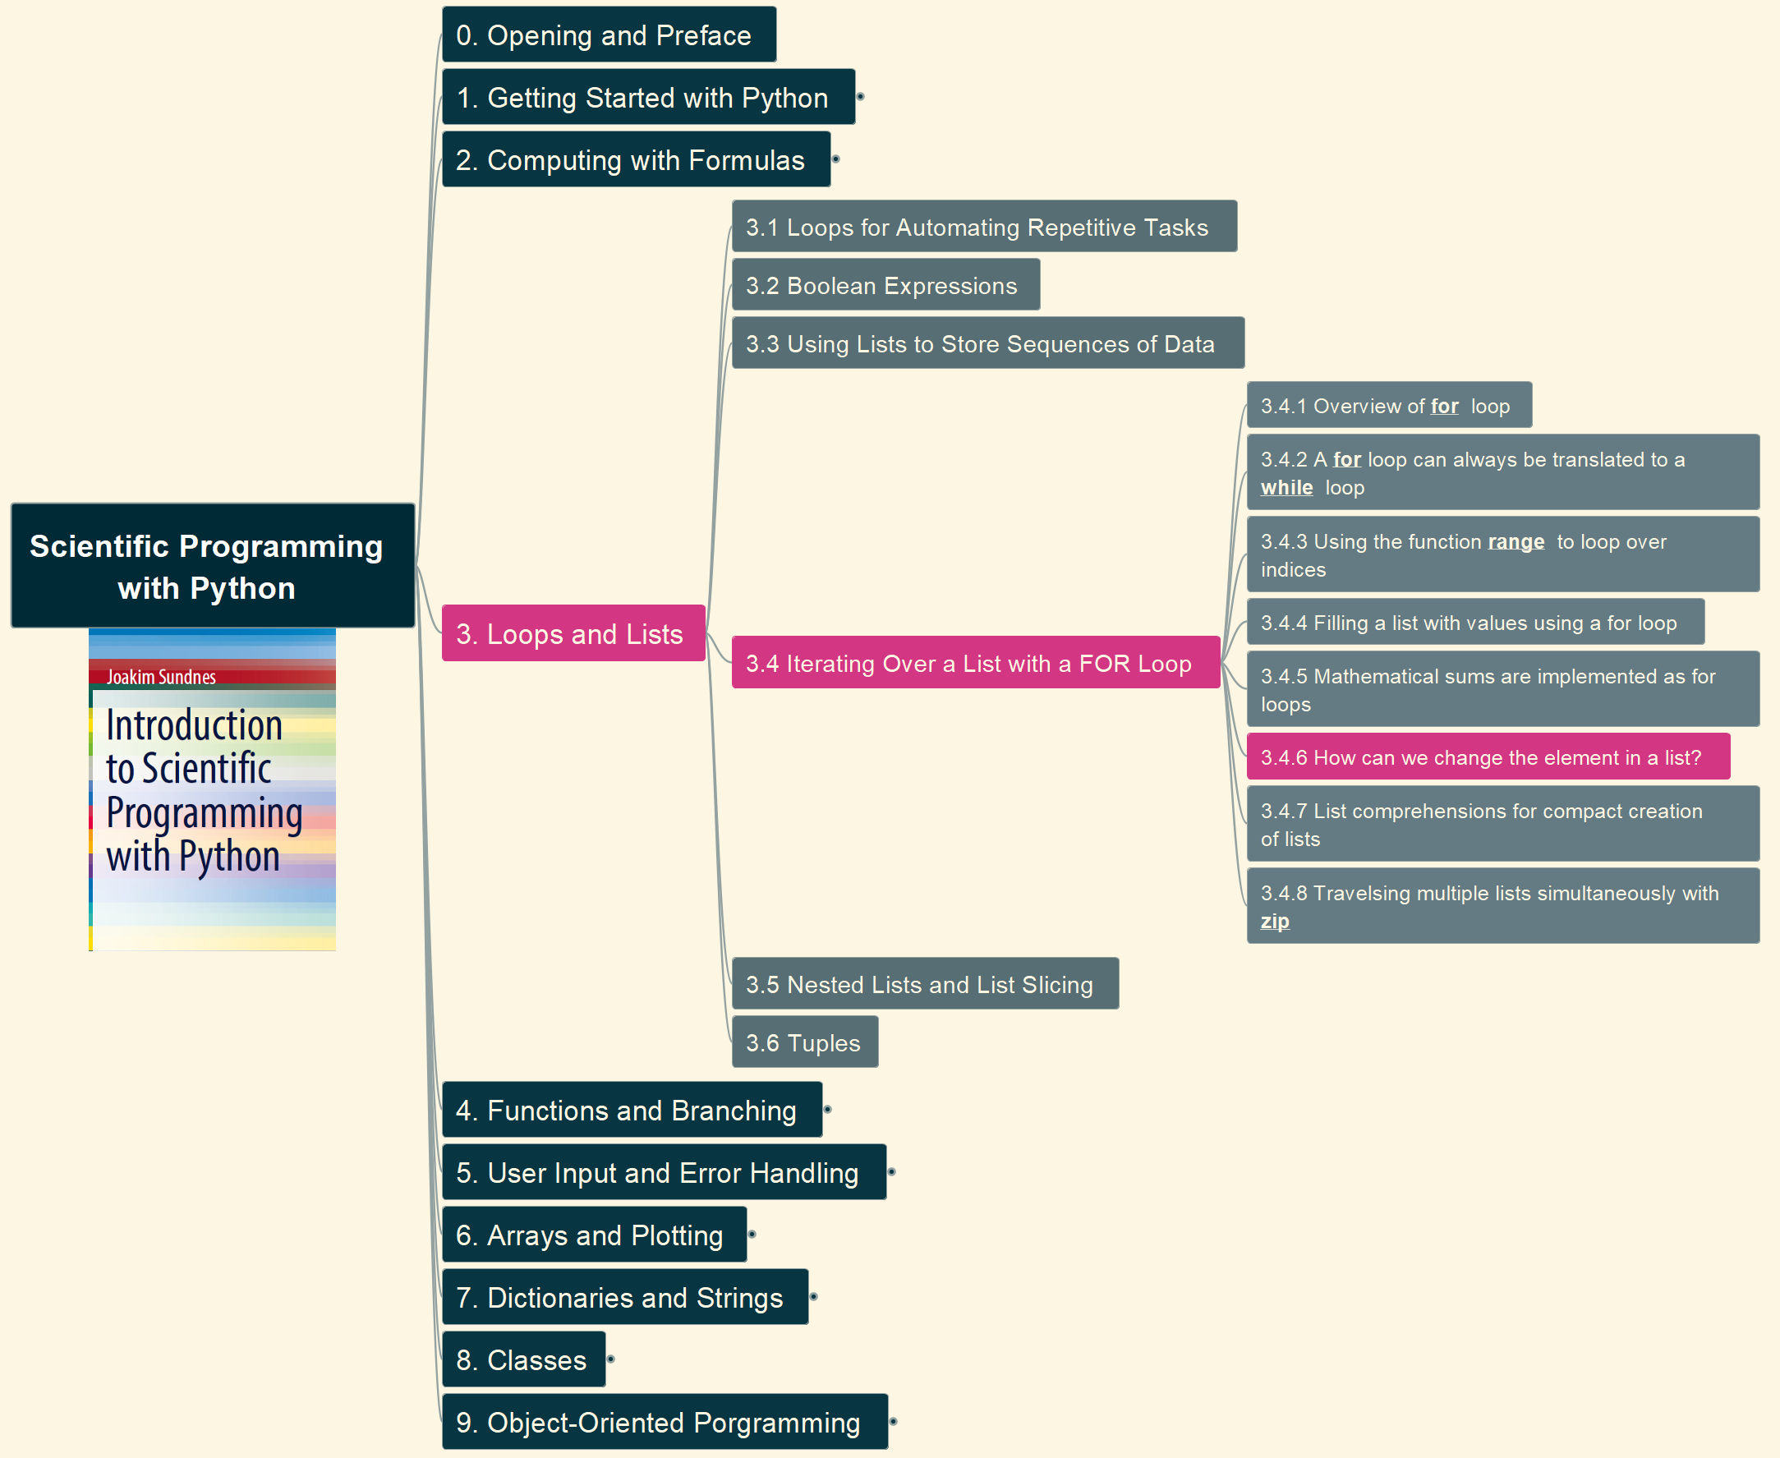
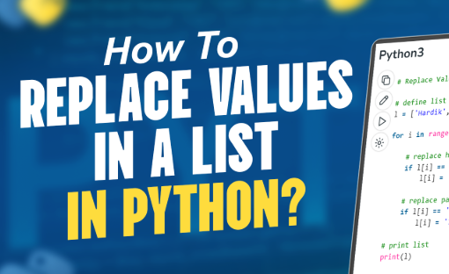
3. Loops and Lists 3.4 Iterating Over a List with a FOR Loop – (3)
015

Slide 16
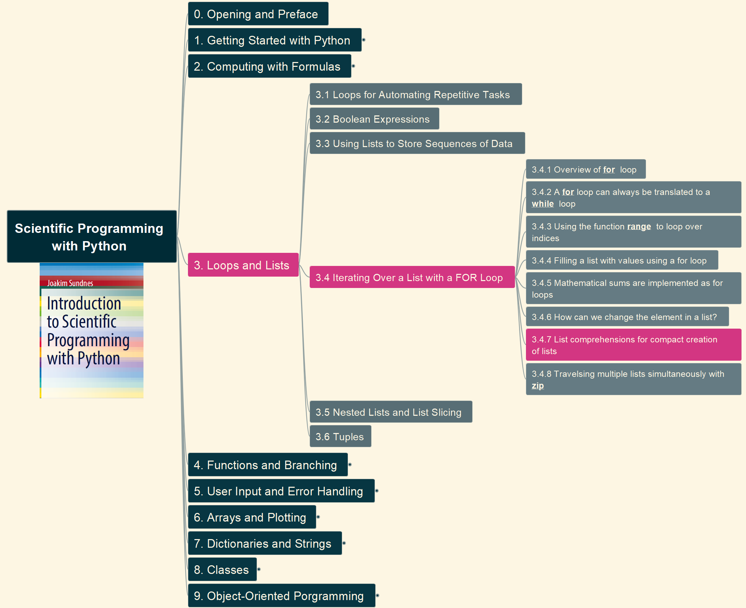
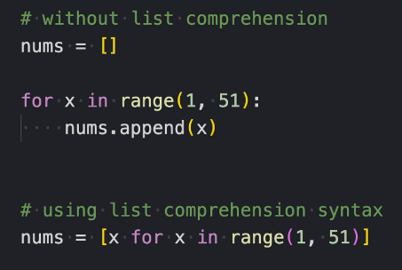
3. Loops and Lists 3.4 Iterating Over a List with a FOR Loop – (4)
016

Slide 17

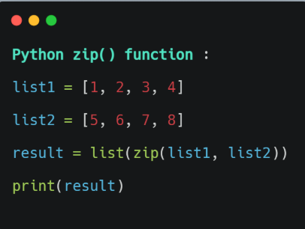
3. Loops and Lists 3.4 Iterating Over a List with a FOR Loop – (5)
017

Slide 18
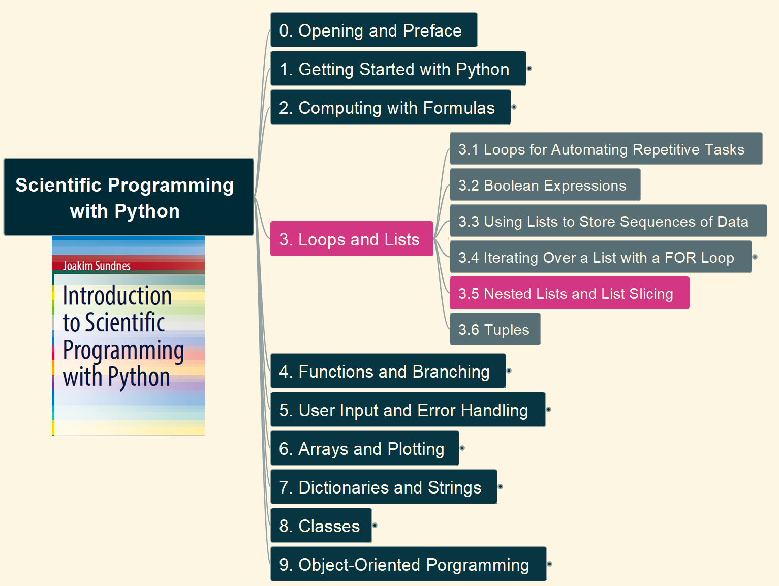
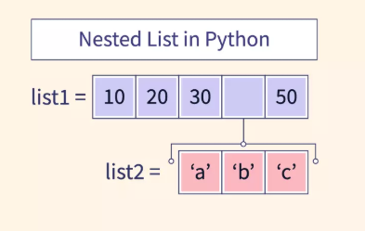
3. Loops and Lists 3.5 Nested Lists and List Slicing – (1) List Nesting
018

Slide 19
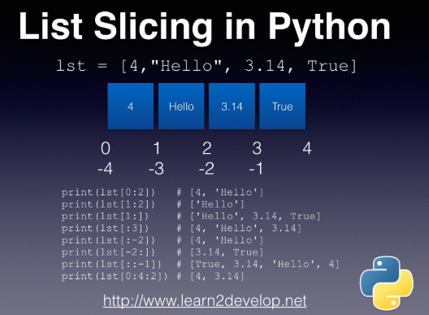
3. Loops and Lists 3.5 Nested Lists and List Slicing - (2) List Slicing
019

Slide 20
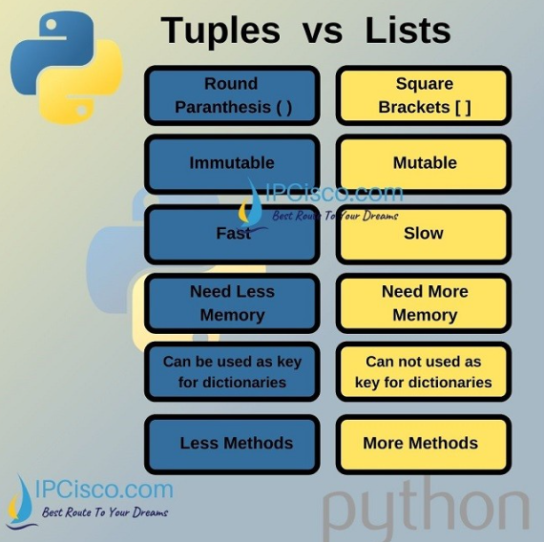
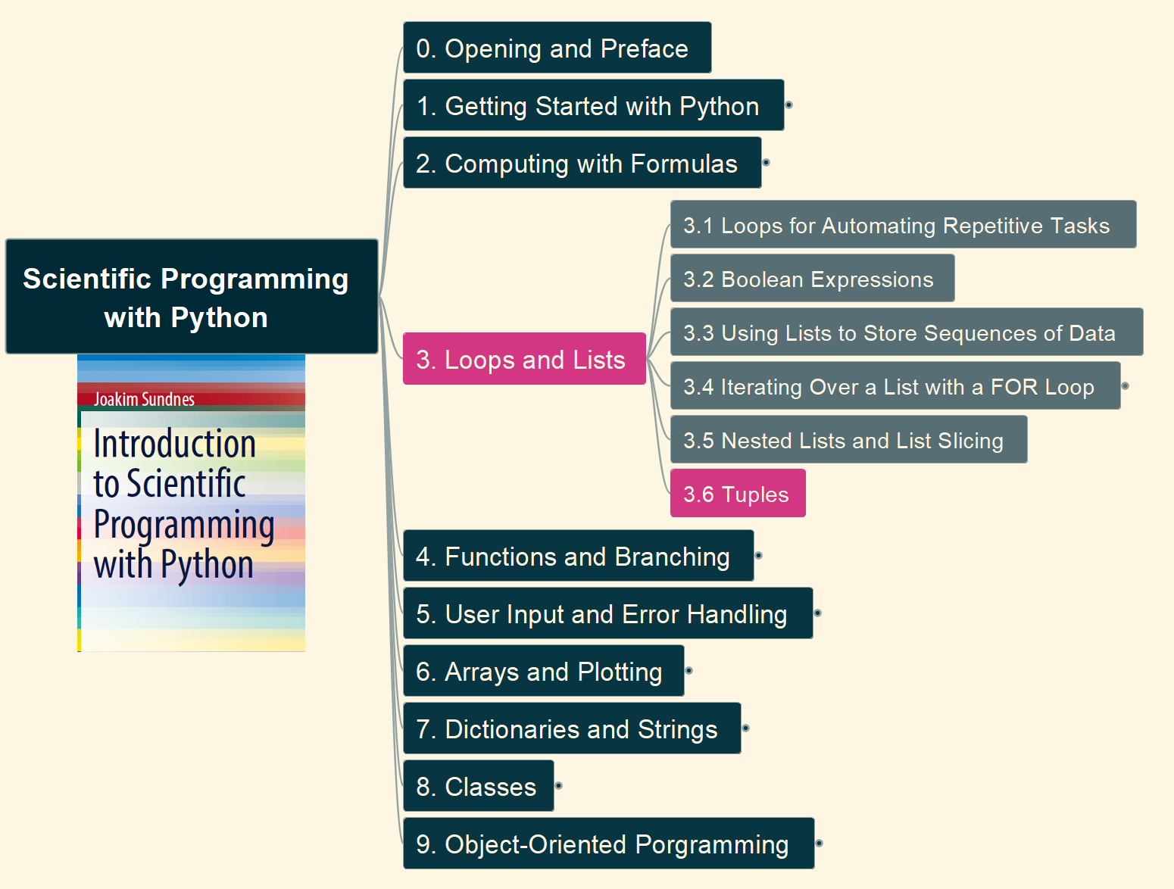
3. Loops and Lists 3.6 Tuples
020

Slide 21
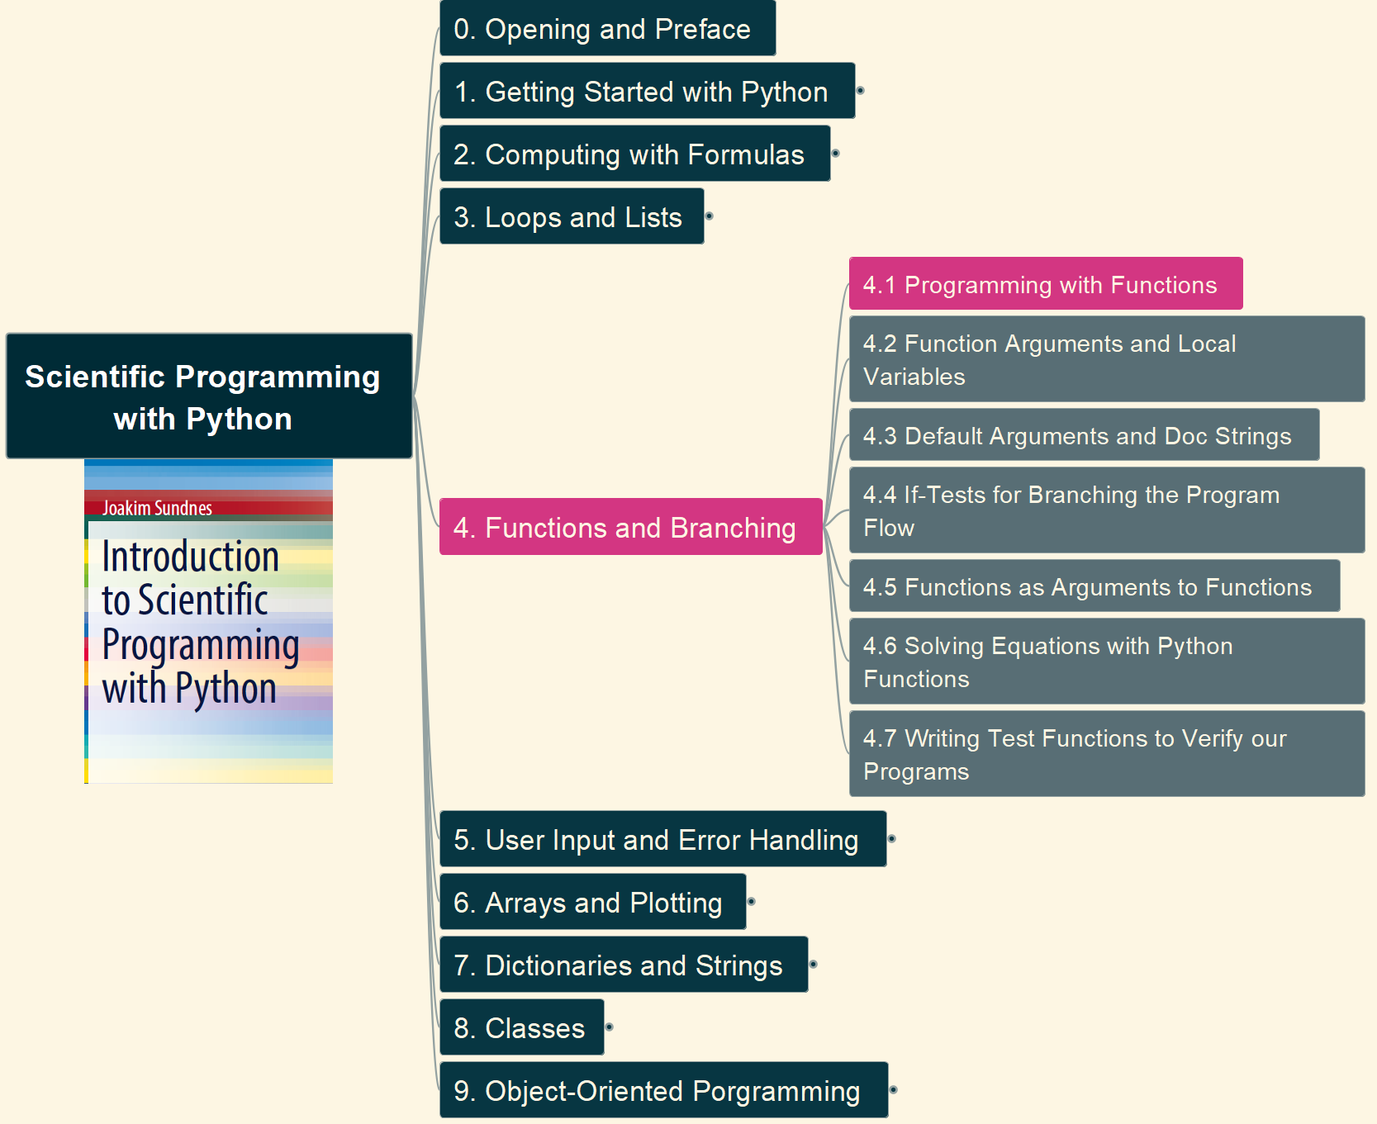
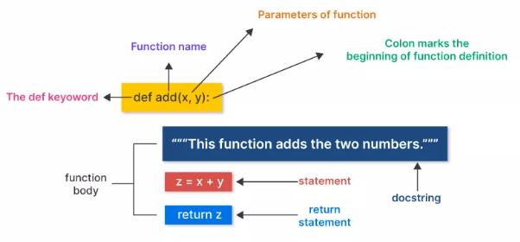
4.Functions and Branching 4.1 Programming with Functions
021

Slide 22
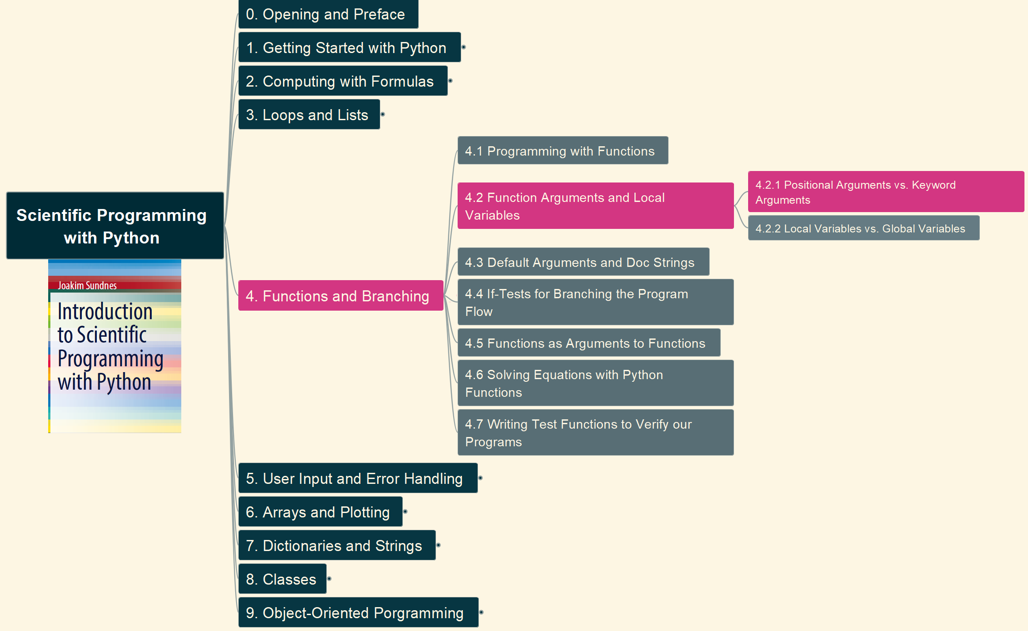
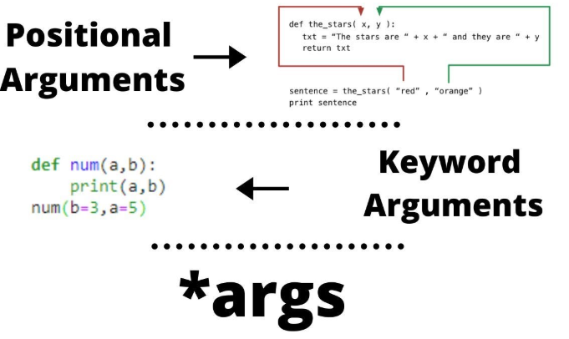
4.Functions and Branching 4.2 Function Arguments and Local Variables – (1)
022

Slide 23
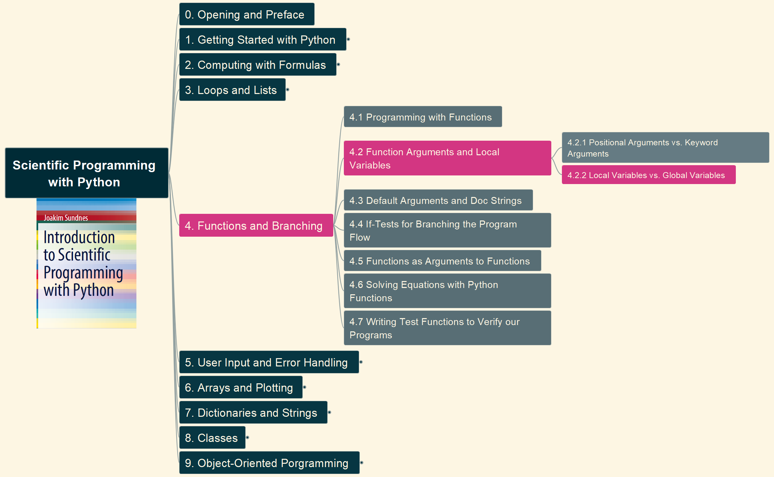
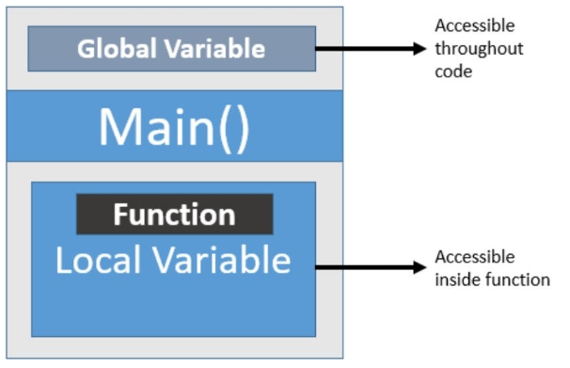
4.Functions and Branching 4.2 Function Arguments and Local Variables – (2)
023

Slide 24
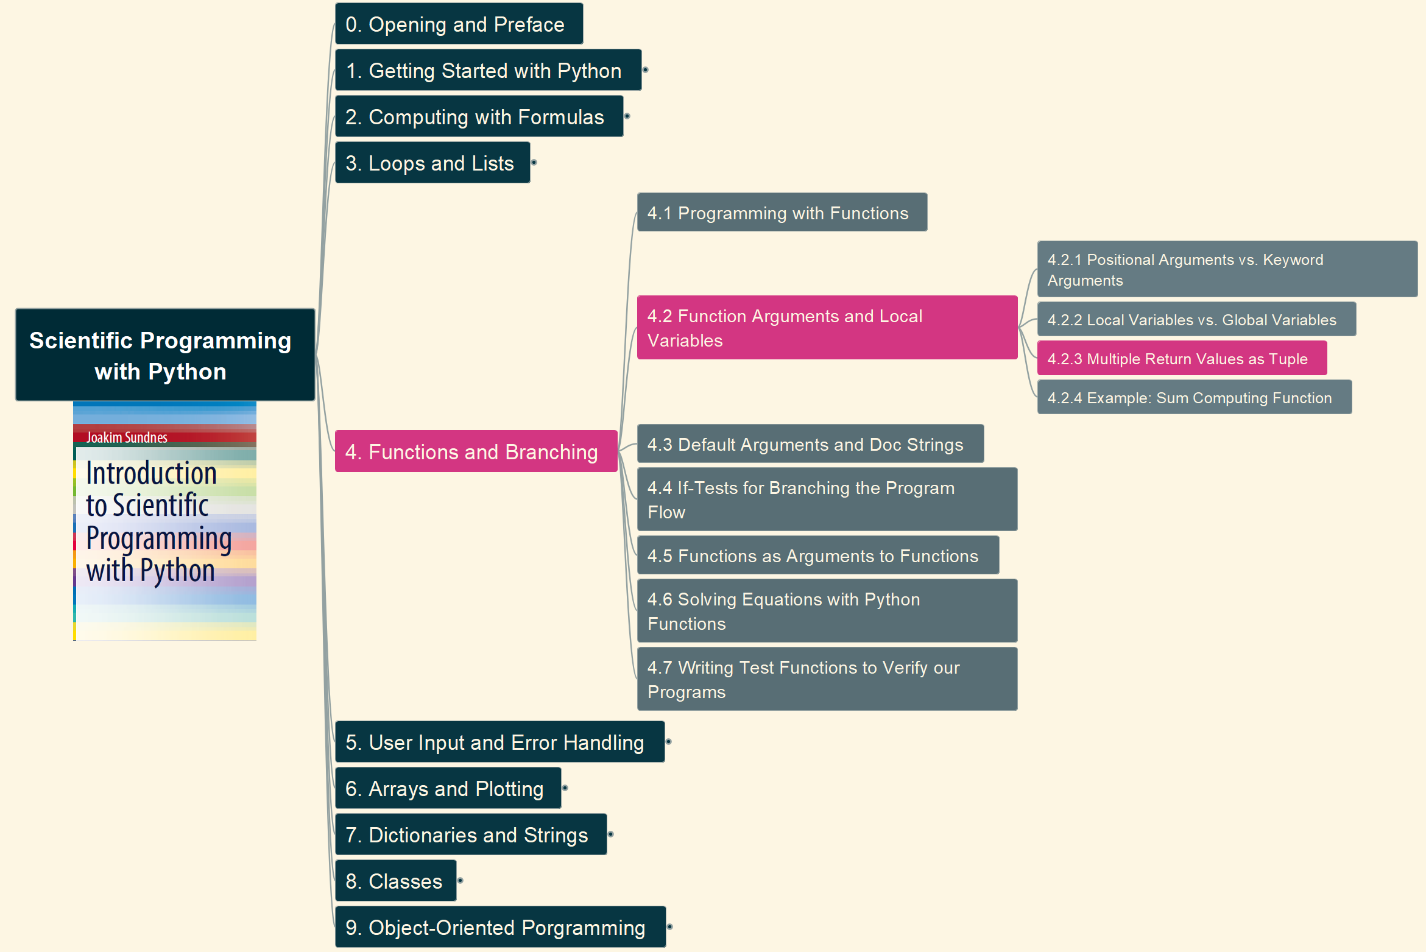
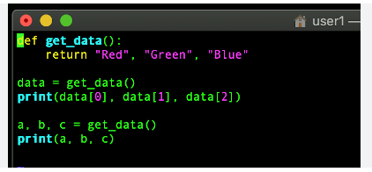
4.Functions and Branching 4.2 Function Arguments and Local Variables – (3)
024

Slide 25
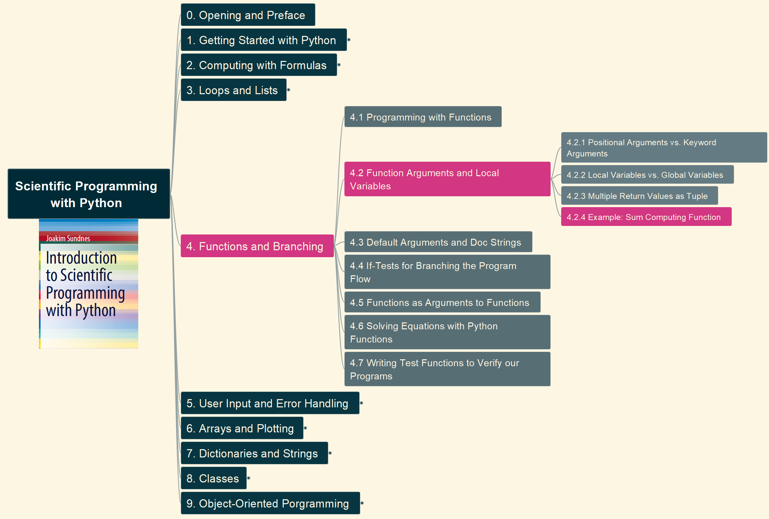
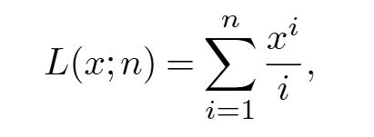
4.Functions and Branching 4.2 Function Arguments and Local Variables – (4)
025

Slide 26
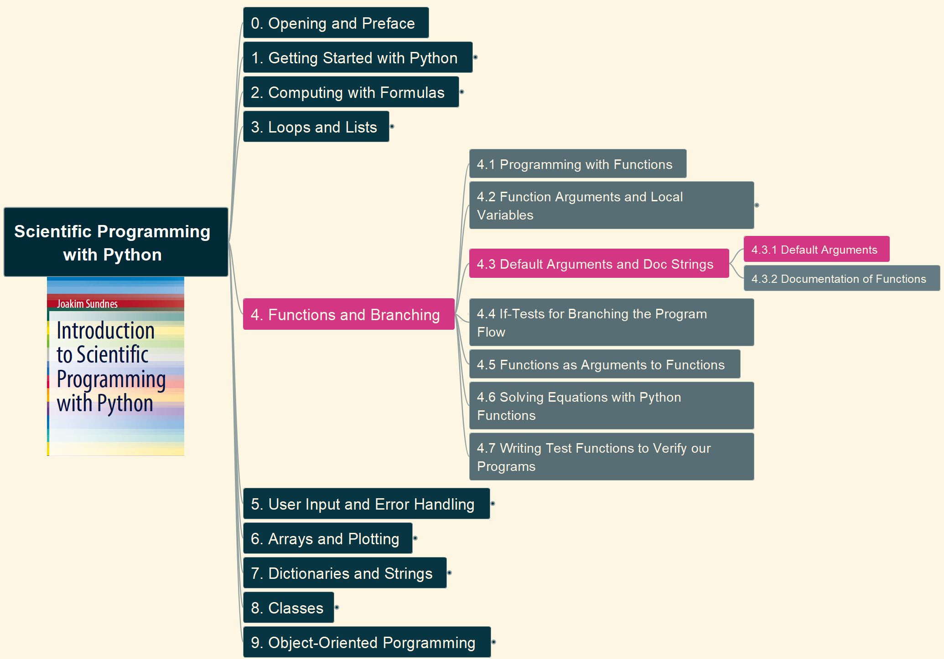
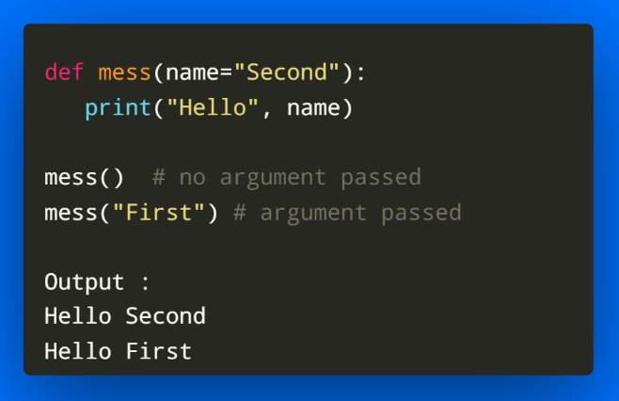
4.Functions and Branching 4.3 Default Arguments and Doc Strings – (1) Default Arguments
026

Slide 27

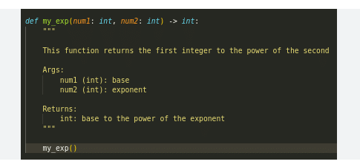
4.Functions and Branching 4.3 Default Arguments and Doc Strings – (2) Documentation of F
027

Slide 28
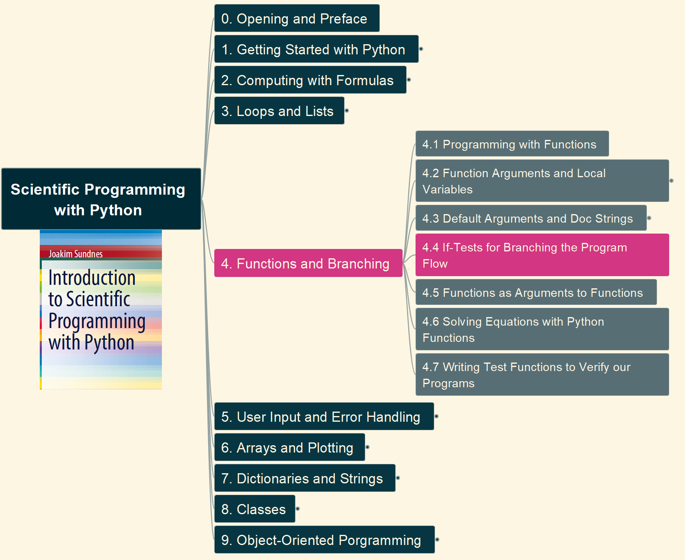
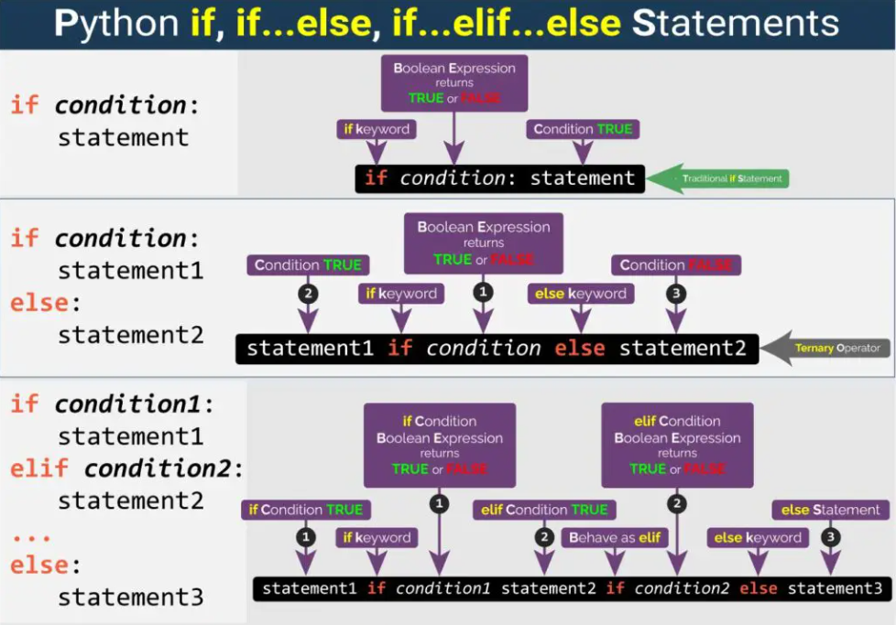
4.Functions and Branching 4.4 IF-Tests for Branching the Program Flow
028

Slide 29


4.Functions and Branching 4.5 Functions as Arguments to Functions / Lambda
029

Slide 30


4.Functions and Branching 4.6 Solving Equations with Functions (1) Bisection Method
030

Slide 31


4.Functions and Branching 4.6 Solving Equations with Functions (2) Newton’s Method
031

Slide 32


4.Functions and Branching 4.7 Writing Test Function to Verify our Programs (1) Basis
032

Slide 33


4.Functions and Branching 4.7 Writing Test Function to Verify our Programs (2) More Tests
033

Slide 34


5. User Input and Error Handling 5.1 Reading User Input Data – (1) Interaction for Inputs
034

Slide 35


5. User Input and Error Handling 5.1 Reading User Input Data – (2) Interaction for Inputs
035

Slide 36


5. User Input and Error Handling 5.2 Flexible User Input (1) using eval
036

Slide 37


5. User Input and Error Handling 5.2 Flexible User Input (2) using exec
037

Slide 38


5. User Input and Error Handling 5.3 Reading Data from Files
038

Slide 39


5. User Input and Error Handling 5.4 Writing Data to Files
039

Slide 40


5. User Input and Error Handling 5.5 Handling Errors in Programs (1) Standard Python Exception
040

Slide 41


5. User Input and Error Handling 5.5 Handling Errors in Programs (2) Program Self Exception
041

Slide 42


5. User Input and Error Handling 5.6 Making Modules
042

Slide 43


6. Arrays and Plotting 6.1 NumPy and Array Computing – Part 1
043

Slide 44

6. Arrays and Plotting 6.1 NumPy and Array Computing – Part 2
044

Slide 45


6. Arrays and Plotting 6.2 Plotting Curves with Matplotlib – Part 1
045

Slide 46

6. Arrays and Plotting 6.2 Plotting Curves with Matplotlib – Part 2
046

Slide 47


6. Arrays and Plotting 6.3 Plotting Discontinuous and Piecewise-Defined Functions
047

Slide 48


6. Arrays and Plotting 6.4 Making a Movie of a Plot – First Alternative
048

Slide 49


6. Arrays and Plotting 6.4 Making a Movie of a Plot – Second Alternative
049

Slide 50


6. Arrays and Plotting 6.4 Making a Movie of a Plot – Third Alternative
050

Slide 51


6. Arrays and Plotting 6.5 More Useful Array Operations
051

Slide 52


7. Dictionaries and String 7.1 Dictionaries – 1. Basis
052

Slide 53


7. Dictionaries and String 7.1 Dictionaries – 2. Similarities with Lists
053

Slide 54



7. Dictionaries and String 7.3 Example: A Dictionary for Polynomials
054

Slide 55


7. Dictionaries and String 7.4 Example: Reading File Data to a Dictionary
055

Slide 56


7. Dictionaries and String 7.5 String Manipulation – 1. String slicing, find and replace
056

Slide 57


7. Dictionaries and String 7.5 String Manipulation – 2. Splitting and Joining String
057

Slide 58


7. Dictionaries and String 7.5 String Manipulation – 3. Other String Methods
058

Slide 59



8. Classes 8.1 Basics of Classes
059

Slide 60


8. Classes 8.2 Protected Class Attributes
060

Slide 61


8. Classes 8.3 Special Methods – 1. Calling (__call__), Printing (__str__)
061

Slide 62


8. Classes 8.3 Special Methods – 2. Math, __repr__ and more
062

Slide 63


8. Classes 8.4 Example: Automatic Differentiation of Functions
063

Slide 64


8. Classes 8.5 Test Functions for Classes
064

Slide 65


8. Classes 8.6 Example: A Polynomial Class
065

Slide 66



9. Object-Oriented Programming 9.1 Class Hierarchies and Inheritance
066

Slide 67


9. Object-Oriented Programming 9.2 Example: Classes for Numerical Differentiation
067

Slide 68


9. Object-Oriented Programming 9.3 Example: Classes for Numerical Integration
068

Slide 69


Introduction to Scientific Programming with Python Summary and Closing
069

Slide 70







My Courses on Python https://www.udemy.com/user/xiaoqi-zhao/

Slide 71




